Slide 1


Co – Founders
Annapurna Marella
Lakshmi Haritha Aluri
Anju Madhukar More
Pavan Kumar Jannaikode
Srimithra Kancharakuntla
Co – Founders
Annapurna Marella
Lakshmi Haritha Aluri
Anju Madhukar More
Pavan Kumar Jannaikode
Srimithra Kancharakuntla
Vision:
For the healthy wellbeing around the world

Slide 2

Target Market
Professionals include community therapists, Psychiatrists, ER doctors, pain management and primary care physicians etc.
Patients include individuals with mental health disorder and individuals with acute problems.
Care Takers help their loved ones to recover from the illness and individuals include parents, relatives, spouse, and children of the adults over 65.

Slide 3



Value Proposition
Mental health parity – Consumers have the right to receive the mental health treatment.
Free of cost – Consumers can get access to the application for free of cost.
User support and satisfaction – Consumers can get access to the healthcare professionals and view the reviews from their peers.
Improved health outcomes – Better living with support and guidance.

Slide 4
Process
Users/Care Takers find it hard to access the appropriate resources.
Support
Users aren’t receiving the support they need during the hard times.
Dependent
Users are dependent on medicines that soothe them, and it affects them in the long term.
Financial
Users are spending money on the health applications without knowing their issue and resulting in an unnecessary spend.
Pain Points

Slide 5

Conceptuation and Justifications
Concept:
Our motto is to serve the community by providing the decision based on the inputs and suggest appropriate resources for the recovery.
Justification:
We offer our application for free, with the help of psychology students and doctors who want to perform volunteer service. It uses the decision algorithm to navigate to appropriate resources. It helps the users to find a solution to their problem in an expedited manner
C P NY N E

Slide 6



Market Research
Pros: Ability to talk to a licensed mental health professional
Cons: More expensive than some other apps
Pros: Ability to access a licensed therapist when you need more support
Cons: Requires a monthly subscription to access advanced features
Cons: Many options are only available if you purchase the premium option
Pros: Developed by experts including therapists and coaches

Slide 7
WHY BETTERU?
BetterU will offer the mental health services for free of cost as a community service.
The present applications in the market are paid subscription and BetterU offers a community driven service for the patients.
We offer immediate support to the user through blogs and videos which are suggested by professionals.
It will benefit the behavioral health patients as they need special care.
It will be helpful for the psychology students to implement their knowledge and help people with the behavioral health issues.
Professionals can volunteer their time to achieve the goal of giving back to the community.

Slide 8
Business Model
Working Collaboratively with patients and caretakers regarding their condition.
Our application is completely Community driven business model offered at free of cost.
Activity group with psychology students who can help the users according to their health condition.
To support users during the financial hardship, we are planning to collect funds and help them fulfil their basic needs

Slide 9

Annapurna Marella : Product Design, database design for the application
The Team
Lakshmi Haritha Aluri :UI, UX Designer, Market Research
Anju Madhukar More :low level view application, backend of the application, Testing.
Pavan Kumar Jannaikode : Wireframe and Research, Information Architecture,SQL
Srimithra Kancharakuntla: Testing, Business model, backend of the application

Slide 10

Starting Strategy
● Agile Methodology, for application development.
● Gathered all functional and non-functional requirements.
● High level view of the application.
● Database design application.
● Low level view of the application.
● Start coding the application.

Slide 11

Communication and Development
● Microsoft outlook email communication.
● Microsoft Team for weekly meeting.
● GitHub for to track changes in code across versions, code sharing, documentation.
● HTML, CSS, Jsp, MySQL

Slide 12
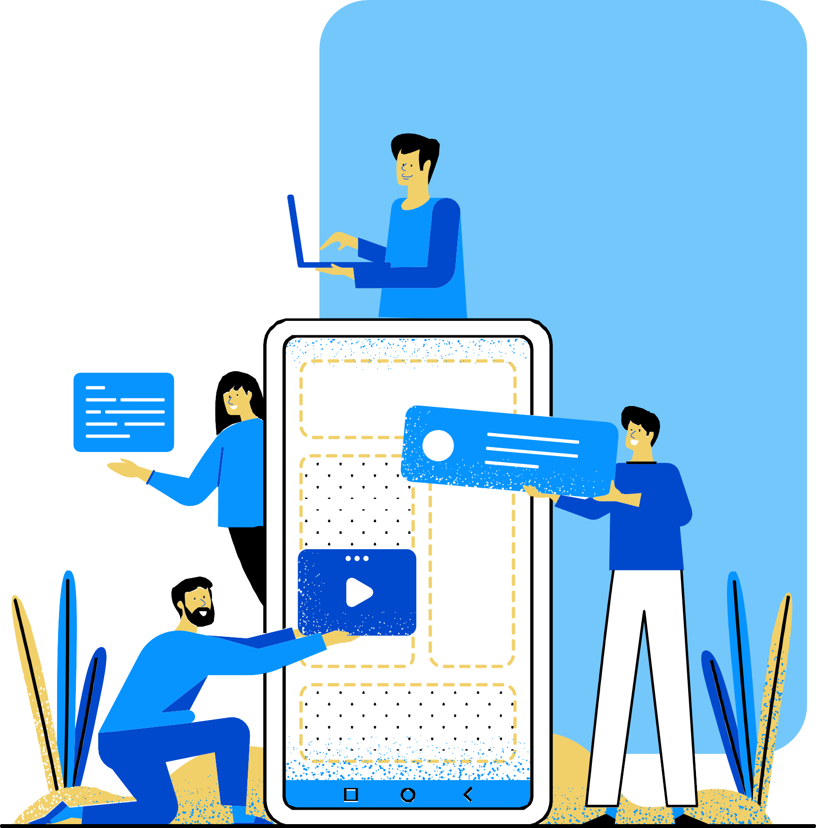
Contact Us
Mailid-teambetteru2021@gmail.com
GitHub-
https://github.com/Pavangit18/BetterU

